Slide 1
Artificial Intelligence
Course Code: CS-202
Topic: Search Algorithms
Instructor: Habiba Arshad

Slide 2
Week-4
This week lecture will cover the following CLO:
CLO 2: . Implement artificial intelligence techniques and case studies

Slide 3
Uninformed Search Algorithm
Blind Search Algorithm and have no additional information about the goal location beyond the problem definition

Slide 4

Uninformed Search Algorithms
Breadth-First Search (BFS)
Explores all nodes at the present depth level before moving on to the next level.
Guarantees finding the shortest path solution.
Depth-First Search (DFS)
Explores as far as possible along each branch before backtracking.
May not find the shortest path and can get stuck in loops.
Uniform Cost Search
Expands the node with the lowest cost, ensuring an optimal solution if costs are non-negative.

Slide 5
Breadth-First Search (BFS)
The algorithm starts from a given source and explores all reachable vertices from the given source. We begin with the given source (in tree, we begin with root) and traverse vertices level by level using a queue data structure.
Working:
Initialization: Enqueue the given source vertex into a queue and mark it as visited.
Exploration: While the queue is not empty:
Dequeue a node from the queue and visit it (e.g., print its value).
For each unvisited neighbour of the dequeued node:
Enqueue the neighbours into the queue.
Mark the neighbour as visited.
Termination: Repeat step 2 until the queue is empty.
Note: Example solve in class

Slide 6
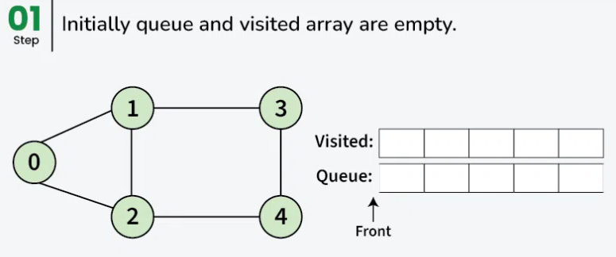
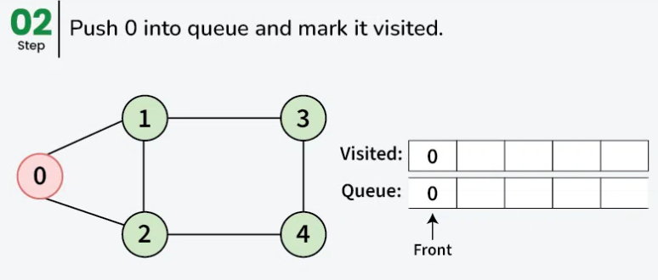
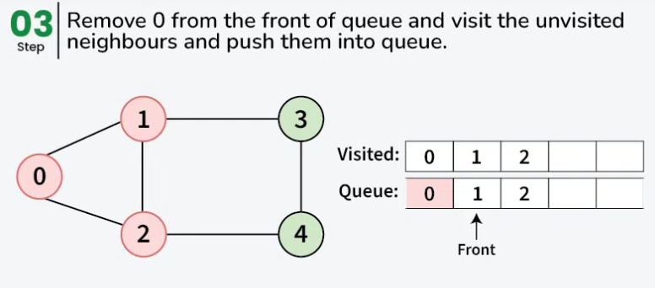
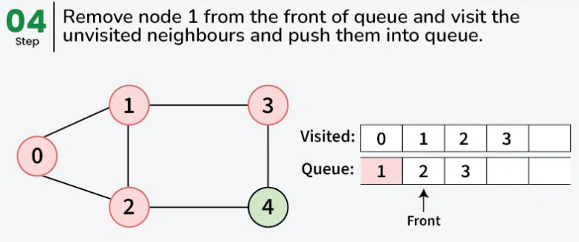
Breadth-First Search (BFS) Example

Slide 7
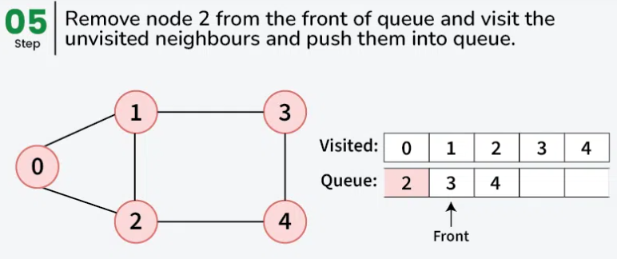
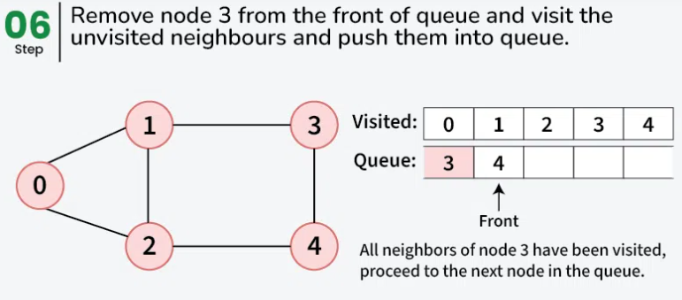
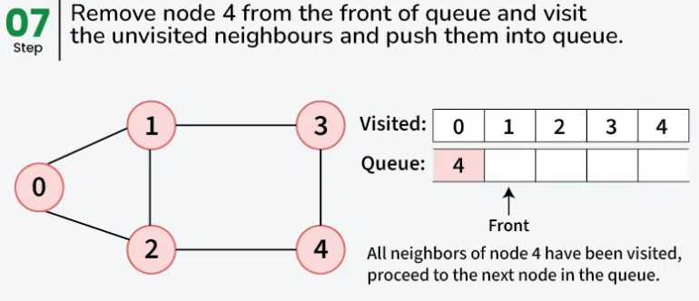

Slide 8
Breadth-First Search (BFS)
Advantages
Completeness
Systematic Exploration
Useful for Finding Closest Solutions
Disadvantages
Time Complexity
High Memory Usage

Slide 9
Depth-First Search (DFS)
Depth-First Search (DFS) is a search algorithm commonly used in artificial intelligence (AI) and graph traversal. It explores as far down a branch as possible before backtracking to explore other branches.

Slide 10
Depth-First Search (DFS) Algorithm
In depth-first search the idea is to travel as deep as possible from neighbour to neighbour before backtracking.
Initialize an empty stack and an empty set for visited vertices.
Push the start vertex onto the stack.
While the stack is not empty:
Pop the current vertex.
If it's the goal vertex, return "Path found".
Add the current vertex to the visited set.
Get the neighbours of the current vertex.
For each neighbour not visited, push it onto the stack.
If the loop completes without finding the goal, return "Path not found“.

Slide 11
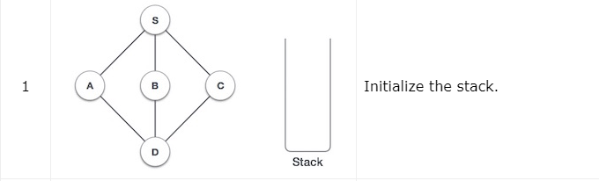
Depth-First Search (DFS) Example

Slide 12
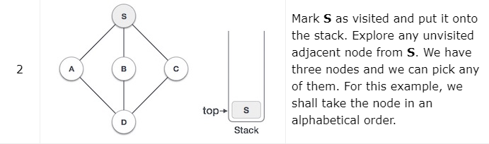
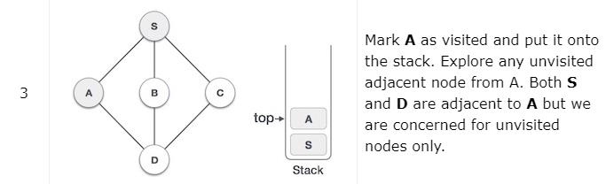
Depth-First Search (DFS) Example

Slide 13
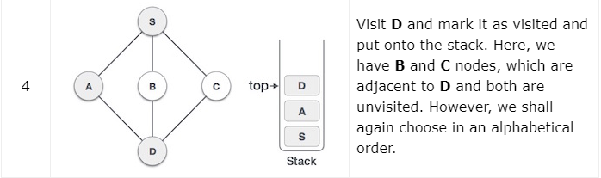
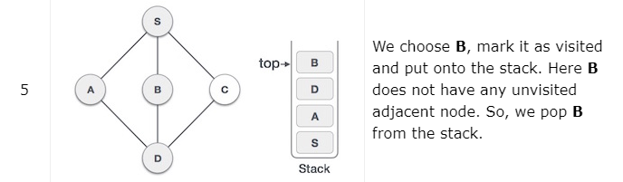
Depth-First Search (DFS) Example

Slide 14
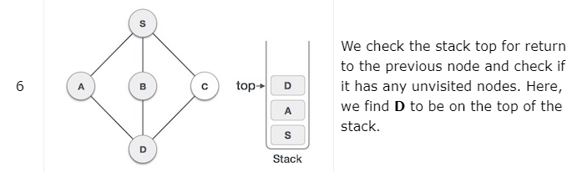
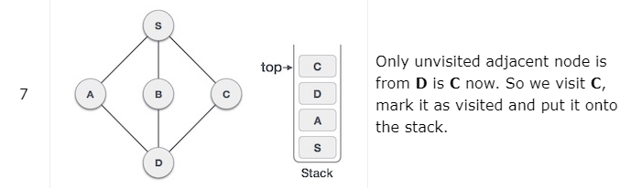
Depth-First Search (DFS) Example

Slide 15
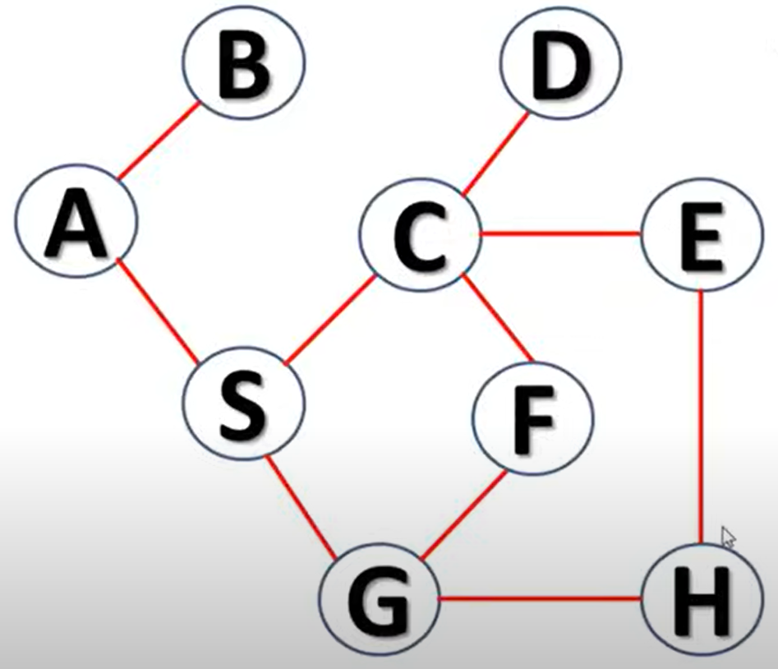
Depth-First Search (DFS) Example

Slide 16
Depth-First Search (DFS)
Advantages
Memory Efficiency
Faster in Finding Feasible Solutions in Deep Trees
Disadvantages
No Guarantee of Finding the Optimal Solution
Not Complete in Infinite Search Spaces

Slide 17
Depth Limited Search
Depth limited search is an uninformed search algorithm which is similar to Depth First Search(DFS). It can be considered equivalent to DFS with a predetermined depth limit 'l'. Nodes at depth l are considered to be nodes without any successors.
Depth limited search may be thought of as a solution to DFS's infinite path problem; in the Depth limited search algorithm, DFS is run for a finite depth 'l', where 'l' is the depth limit.

Slide 18
Depth Limited Search Algorithm
We are given a graph G and a depth limit 'l'. Depth Limited Search is carried out in the following way:
Set STATUS=1(ready) for each of the given nodes in graph G.
Push the Source node or the Starting node onto the stack and set its STATUS=2(waiting).
Repeat steps 4 to 5 until the stack is empty or the goal node has been reached.
Pop the top node T of the stack and set its STATUS=3(visited).
Push all the neighbours of node T onto the stack in the ready state (STATUS=1) and with a depth less than or equal to depth limit 'l' and set their STATUS=2(waiting). (END OF LOOP)
END

Slide 19
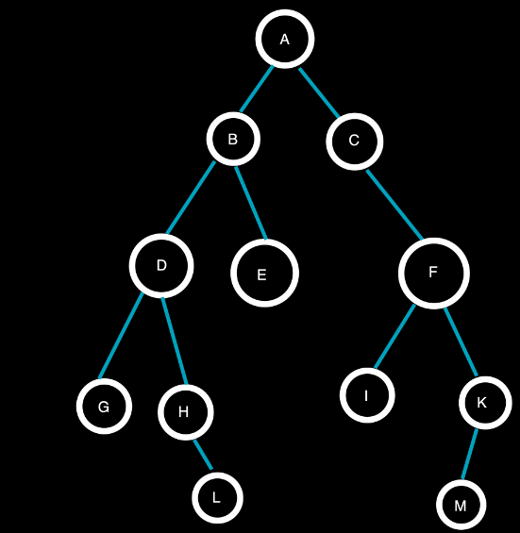


Depth Limited Search Example
Consider the given graph with Depth Limit(l)=2, Target Node=H and the given source node=A
Step 1
Step 2
A being the top element is now popped from the stack and the neighbouring nodes B and C at depth=1(<l) of A are pushed onto the stack.
Traversal: A

Slide 20


Depth Limited Search Example
Step 3
Step 4
C being the topmost element is popped from the stack and the neighbouring node F at depth=2(=l) is pushed onto the stack.
F being the topmost element is popped from the stack and the neighbouring nodes I and K at depth=3(>l) will not be pushed onto the stack.
Traversal: AC
Traversal: ACF

Slide 21


Depth Limited Search Example
Step 4
Step 6
B being the topmost element is popped from the stack and the neighbouring nodes D and E at depth=2(=l) are pushed onto the stack.
E being the topmost element is popped from the stack and since E has no neighbouring nodes, no nodes are pushed onto the stack.
Traversal: ACFB
Traversal: ACFBE

Slide 22

Depth Limited Search Example
Step 7
Since the stack is now empty, all nodes within the depth limit have been visited, but the target node H has not been reached.
D being the topmost element is popped from the stack and the neighbouring nodes G and H at depth=3(>l) will not be pushed onto the stack.
Traversal: ACFBED

Slide 23
Depth Limited Search (DLS)
Advantages
Memory Efficiency
Useful for Large or Infinite Search Spaces
Controls Depth in Applications with Known Solution Depths
Disadvantages
Incomplete
Requires Prior Knowledge of Solution Depth
Sensitive to Depth Limit Selection

Slide 24
Iterative Deeping Depth First Search
Iterative Deepening Depth-First Search (IDDFS) is a hybrid search algorithm that combines the benefits of Depth-First Search (DFS) and Breadth-First Search (BFS). It systematically increases the depth limit of the search in a depth-first manner, ensuring completeness and optimality similar to BFS while using much less memory.
Solved example on board

Slide 25
Iterative Deeping Depth First Search Algorithm
The Algorithm performs a series of depth-limited DFS searches, starting from a depth limit of 0 and increasing the limit incrementally until the goal is found.
For each depth limit L:
Perform a DFS, but only expand nodes up to depth 𝐿.
If the goal is found within this depth, the search stops.
Otherwise, increase the depth limit by 1 and repeat.
Continue until the goal is found or all nodes are explored.

Slide 26
Iterative Deeping Depth First Search Algorithm (IDDFS)
Advantages
Memory Efficiency
Optimal Solution
IDDFS uses the low memory of DFS and the optimal, complete nature of BFS
Disadvantages
Repetitive Exploration
Not Suitable for All Problems where the branching factor is very high

